Slide 1
PubMed Network Visualization
Group 4: Anirudh Negi, Junfeng Zhao, Yibo Zhou

Slide 2
Project Goal
We want to create a meaningful visualization that is able to represent every single row in our dataset, with the main strategy involving taking in the data in a streaming context.
Can clustering algorithms (k-means, CURE) help identify meaningful relationships?
Can ranking algorithms (PageRank, TrustRank) help identify the quality of an attribute value?

Slide 3
Dataset
PubMed Database
Total number of files: 1062
Original data size(.xml) ~ 150-200GB
Location: https://ftp.ncbi.nlm.nih.gov/pubmed/baseline/
After Conversion to csv:
Total citations: 31,851,988 (31.8 Million approx) ~ (9GB approx)
Total edges between them: 214,169,935 (214.2 Million approx) ~ (2GB approx)
List of attributes: https://www.nlm.nih.gov/bsd/licensee/elements_alphabetical.html

Slide 4
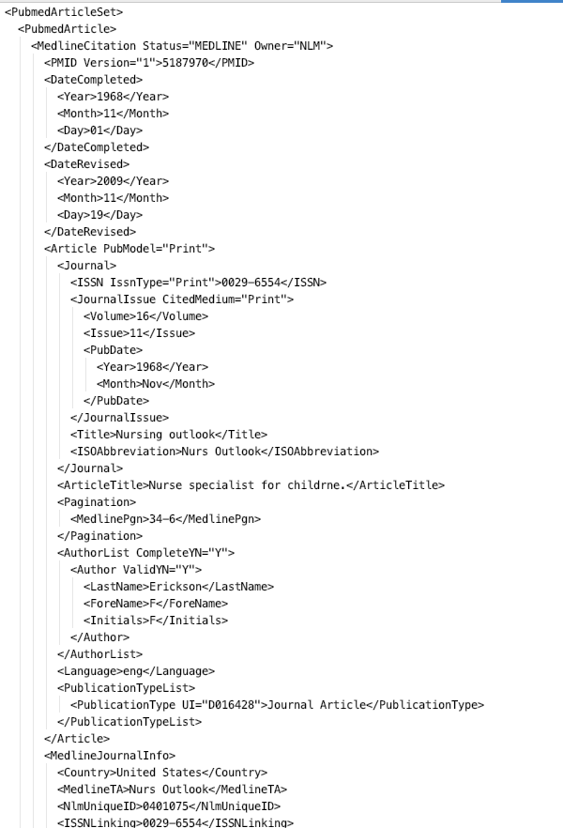
Data Transformation, Reduction & Cleaning
pmid | article_title | ... | reference_ids
... | ... | ... | ...
518770 | Nurse specialist for childrne. | ... | 121,101,91
518771 | Colombian student nurses learn to teach. | ... | 112,43
... | ... | ... | ...
Pubmed csv file
Pubmed original file

Slide 5
Building graph data
Source | Target
... | ...
518770 | 121
518770 | 101
518770 | 112
518771 | 112
518771 | 43
... | ...
pmid | article_title | ... | reference_ids
... | ... | ... | ...
518770 | Nurse specialist for childrne. | ... | 121,101,112
518771 | Colombian student nurses learn to teach. | ... | 112,43
... | ... | ... | ...
Pubmed Data
Pubmed Citation Network

Slide 6
Questions
Can we rank the “trustworthiness” of attributes like author, journal or article using PageRank?
Can we visualize associations among attributes like author, journal or articles?
Can we process a massive dataset (30 million rows, > 10GB) efficiently using a streaming context? What will be the major challenges here?

Slide 7
Tools
Programming language: python
Libraries: kafka, pyspark, pyclustering, nltk, gensim, sklearn, spacy
Data Processing: Apache Kafka, Apache Spark
Visualization: Bokeh, Gephi and Tableau

Slide 8
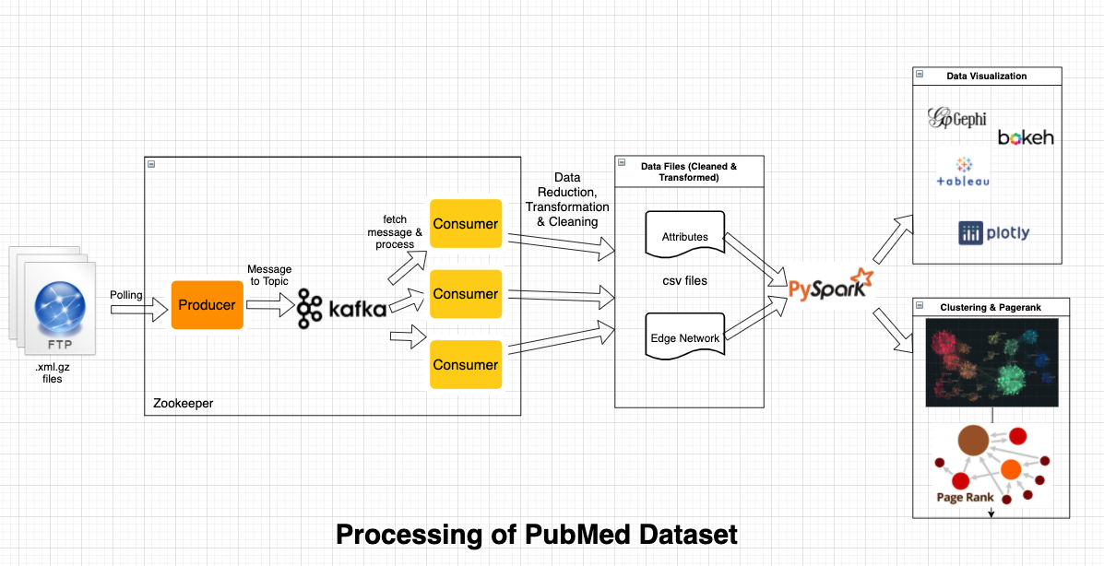
Data Workflow

Slide 9
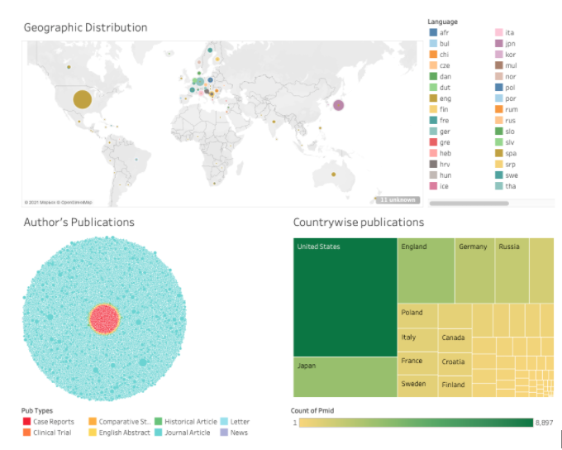
Interface Mockup/ Visualization

Slide 10
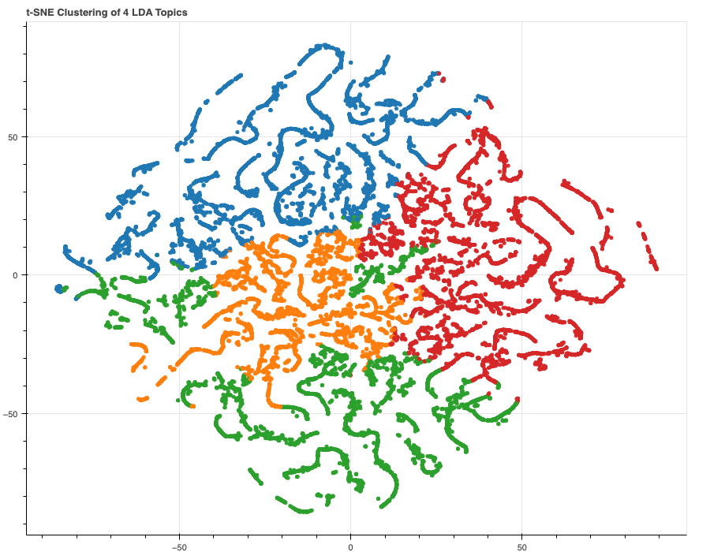
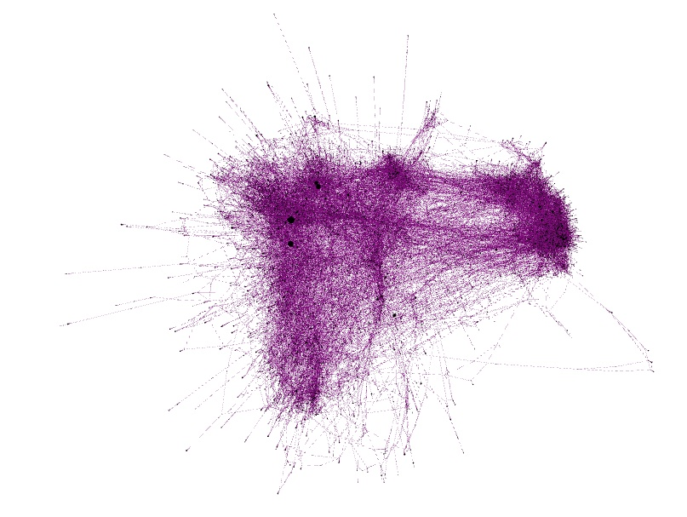
Sample Visualizations
Fig: ForceAtlas using Gephi
Fig: TSNE (t-distributed stochastic neighbor embedding clustering)

Slide 11
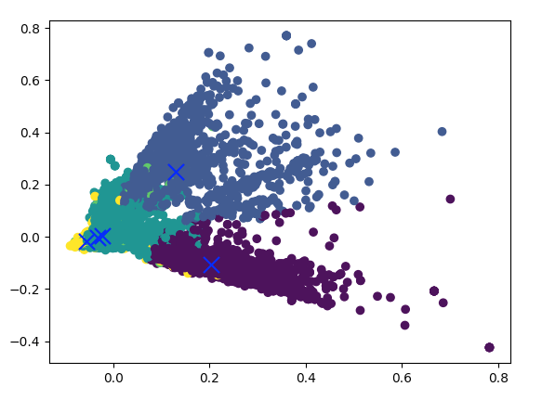
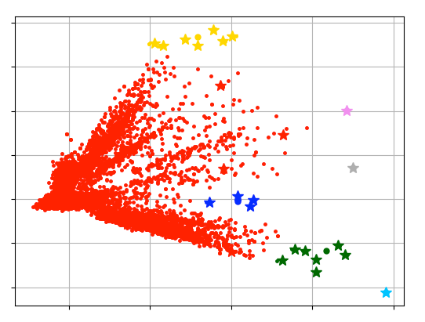
Clustering
Fig: using miniBatchKMeans
Fig: using CURE

Slide 12
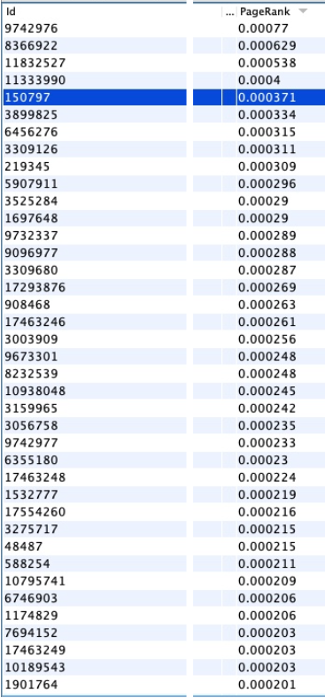
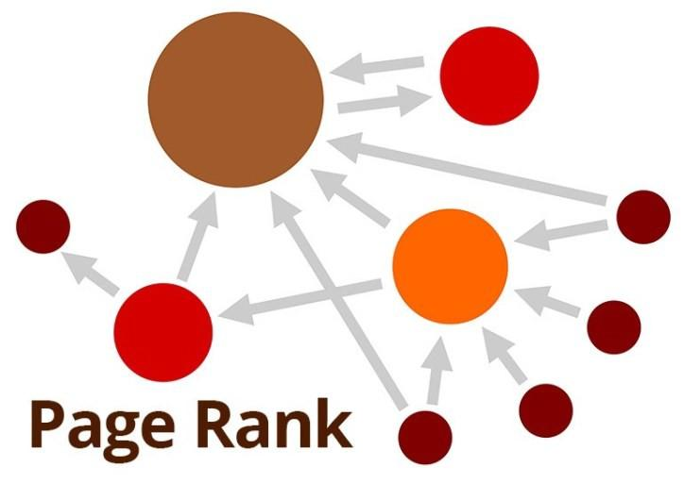
Page Rank

Slide 13
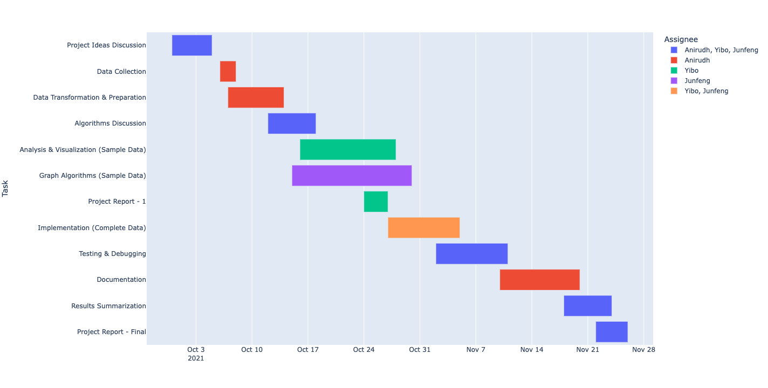
Timeline

Slide 14
References
PubMed Dataset: https://ftp.ncbi.nlm.nih.gov/pubmed/baseline/ , https://www.nlm.nih.gov/databases/download/pubmed_medline_documentation.html
Apache spark: http://spark.apache.org/docs/latest/graphx-programming-guide.html, https://medium.com/@nitingupta.bciit/apache-spark-streaming-from-text-file-fa40155b7a21
Apache Kafka: https://towardsdatascience.com/quickstart-apache-kafka-kafka-python-e8356bec94
Vaex: https://vaex.io/blog/how-to-analyse-100s-of-gbs-of-data-on-your-laptop-with-python
Gephi: https://gephi.org/
Tableau: https://www.tableau.com/
Bokeh: https://docs.bokeh.org/en/latest/
PyClustering: https://pyclustering.github.io/docs/0.8.2/html/index.html
PageRank: https://livebook.manning.com/book/mastering-large-datasets/chapter-9/45

Slide 15

Team Members
Anirudh Negi
(an721)
Junfeng Zhao
Yibo Zhou (yz1119)

